Slide 1
EECT111 Notes
Using MultiSim, Excel and hand calculations create a set of notes that show how to:
1.) Multiple resistors combine in series and parallel.
2.) By example calculate R_{T}, I_{T}, P_{T}, and all the nodal voltages, branch currents and power
dissipation of a resistor network.
3.) By example calculate the Thevenin Resistance and Voltage of a resistor network.
4.) Multiple capacitors combine in series and parallel.
5.) Multiple inductors combine in series and parallel.
6.) Using a simple RC circuit determine the
a.) Time Constant. Create a graph that shows the RC time constant as a function of time
b.) Determine X_{C} at a fixed frequency. Create a graph that shows how X_{C} changes as a function of frequency
7.) Using a simple RL circuit determine the
a.) Time Constant
b.) Create a graph that shows the RL time constant as a function of time
b.) Determine X_{L} at a fixed frequency
d.) Create a graph that shows how X_{L} changes as a function of frequency

Slide 2
EECT111 Notes - Resistors
1.) Multiple resistors combined in series and parallel
Series
Parallel – more than 3 unequal resistors
Parallel – multiple equal value resistors
Parallel – two unequal value resistors

Slide 3
EECT111 Notes
2.) R_{T}, I_{T}, P_{T}, and all the nodal voltages, branch currents and power
dissipation of a resistor network.

Slide 4
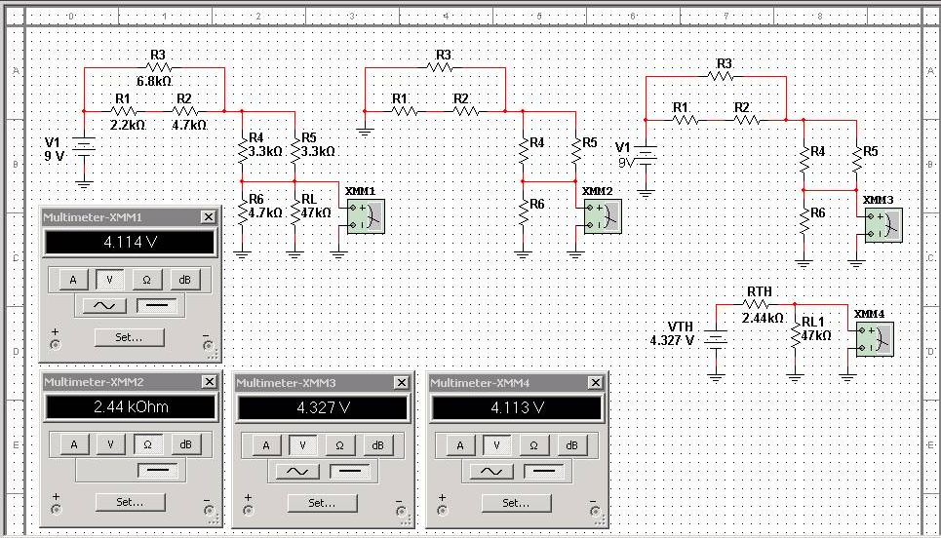
EECT111 Notes
3.) Thevenin Resistance and Voltage of a resistor network.

Slide 5
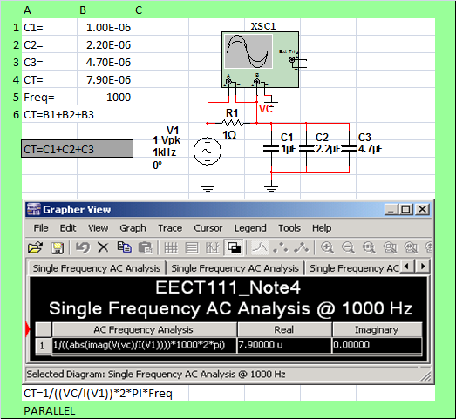
EECT111 Notes
4a.) Capacitors in parallel

Slide 6
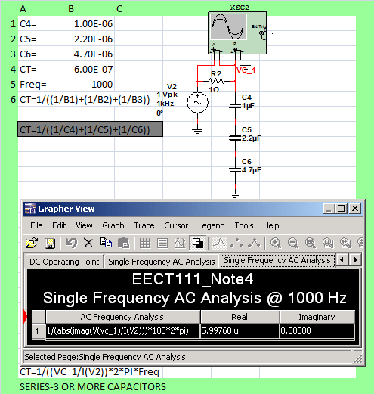
EECT111 Notes
4b.) Two or more unequal capacitors in series

Slide 7
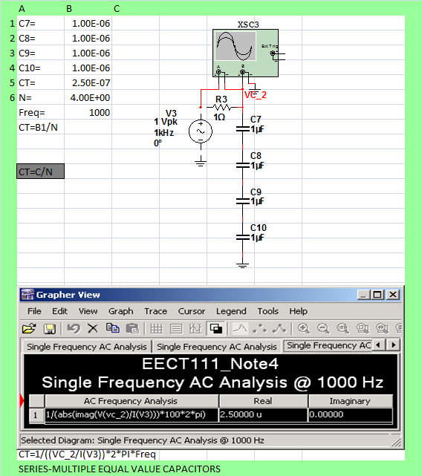
EECT111 Notes
4c.) Capacitors of equal value in series

Slide 8
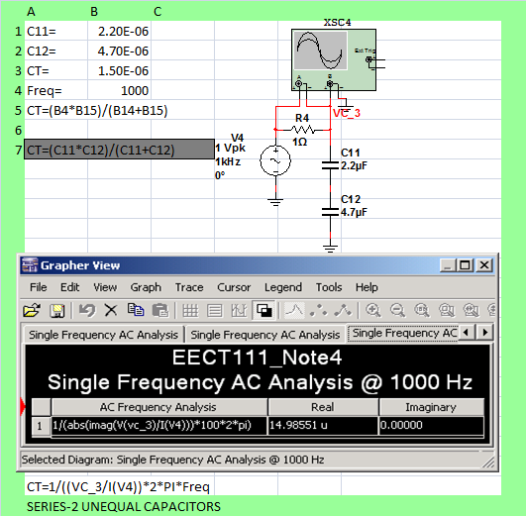
EECT111 Notes
4d.) Only 2 Capacitors in series

Slide 9
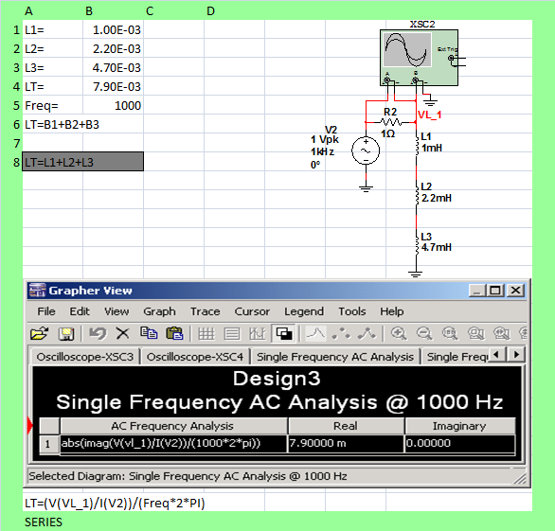
EECT111 Notes
5a.) Inductors in series

Slide 10
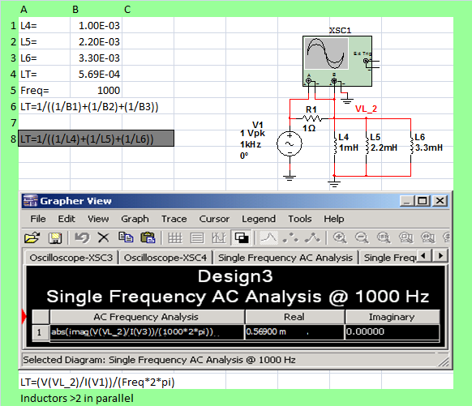
EECT111 Notes
5b.) Three or more unequal inductors in parallel

Slide 11
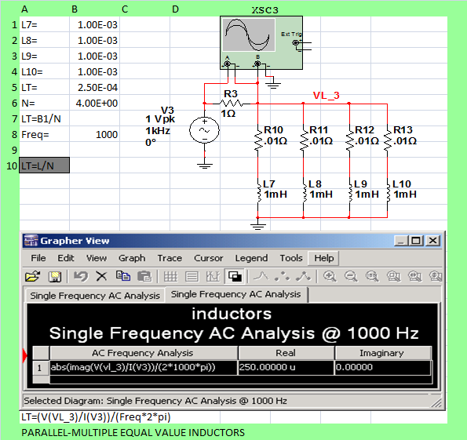
EECT111 Notes
5c.) Multiple equal value inductors in parallel

Slide 12
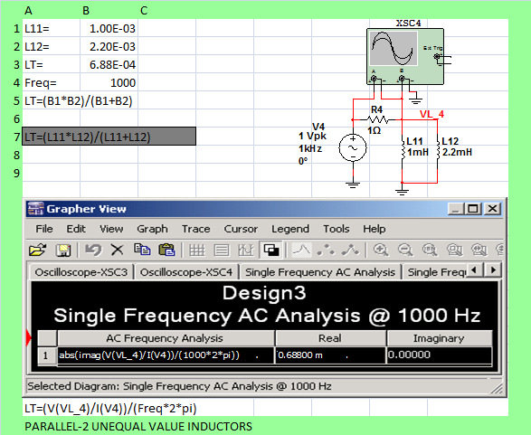
EECT111 Notes
5d.) Two unequal value inductors in parallel

Slide 13
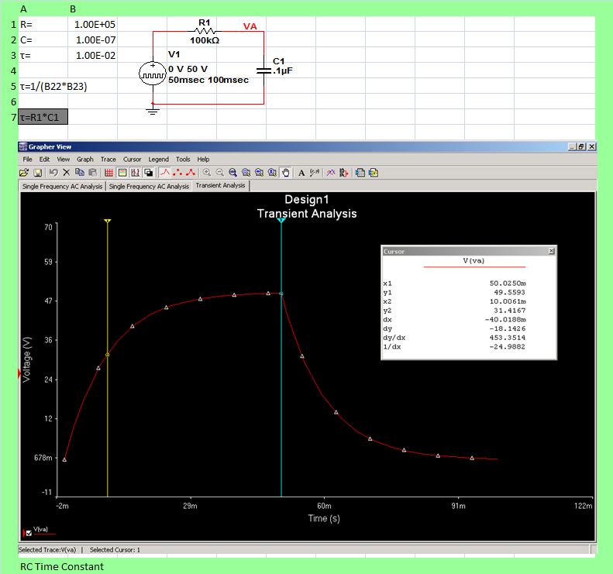
EECT111 Notes
6a.) RC Time Constant

Slide 14
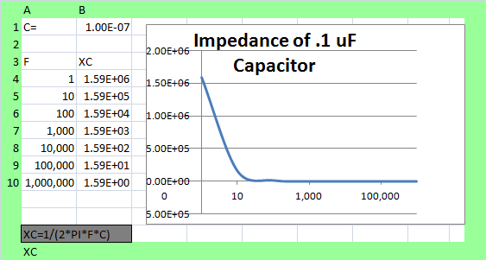
EECT111 Notes
6b.) XC & Capacitor Impedance

Slide 15
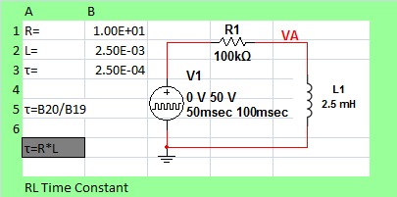
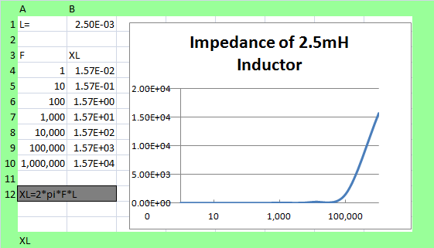
EECT111 Notes
7.) RL Time Constant & XL & Inductor Impedance

